Slide 1
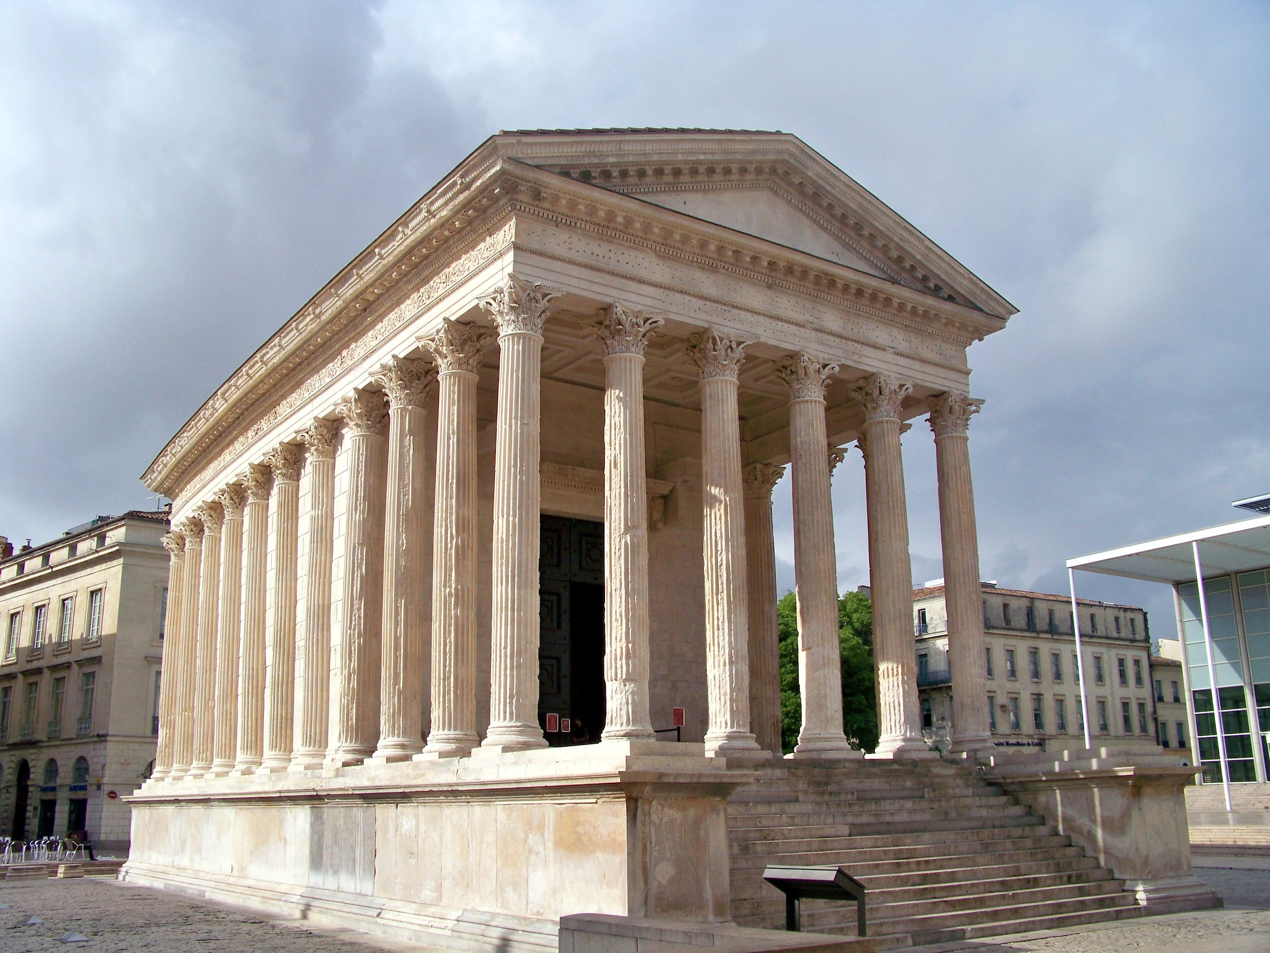
Roman Temples
By Milin and Loz

Slide 2
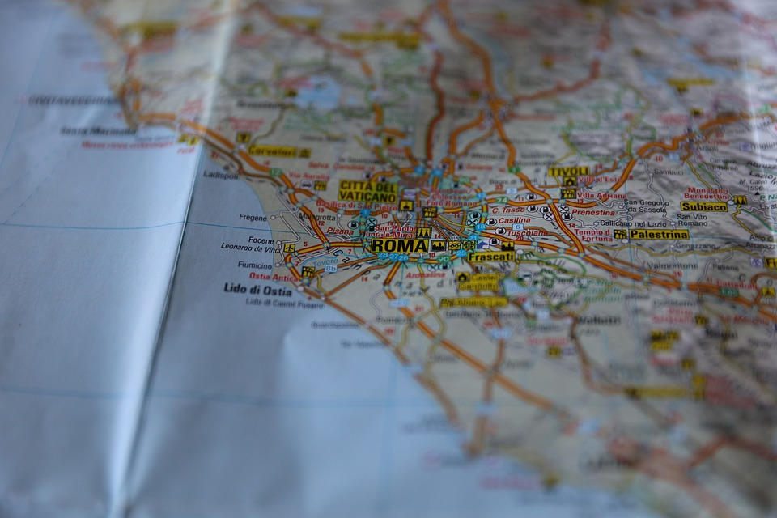
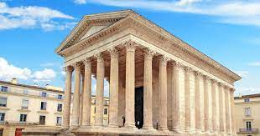
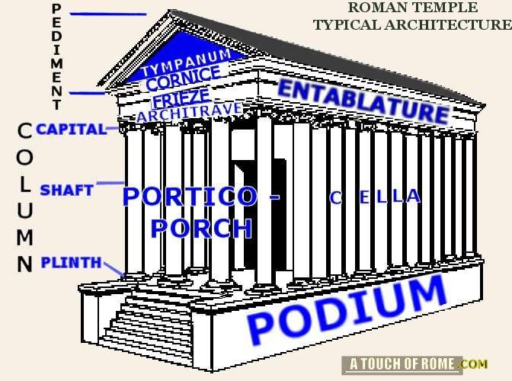
What Does a Roman Temple Look Like?
Here is ruins of an ancient Roman temple On this side we have a drawing of a Roman Temple

Slide 3
Why Were Roman Temples Built?
Roman temples were the visual embodiment of Roman religion and were central to Roman life.
The interactions between the Romans and their gods were very amazing.
They were designed to accustom a deity and be a place of worship for that god.
Roman Temples were designed as this was a road to success of Rome
Roman temples were like a church in which people went to pray, apologize for sins, and make a deposit.
Roman Temples were also another way to tell the Roman God everything you hope for.

Slide 4
Why Are These Temples Significant?
Roman Temples are a place for the Romans to worship their gods in the Roman religion.
At these temples there would be a public religious ceremony. These ceremonies took place outside of the Roman temple as many people did not know they were occurring.
Sometimes there Roman worshiping took place inside the temple. The reason of this is to deposit offers that Roman citizens make to give to the Gods.
People often came to Roman Temples to confess their sins and cleanse their wrong doing, this was done to be a better person.
Many people thought that confessing their sins and apologizing for their wrongs would please the God.

Slide 5
Extra Fun Facts About Romans.
The colosseum was Rome’s greatest fighting arena.
Rome’s architectural mastery is from their excessive use of concrete.
The Pantheon Dome in Rome is the largest circular dome that has the least support of concrete.
Romans had chariot racing in the Circus Maximus.
There was a maze like area inside the colosseum.

Slide 6
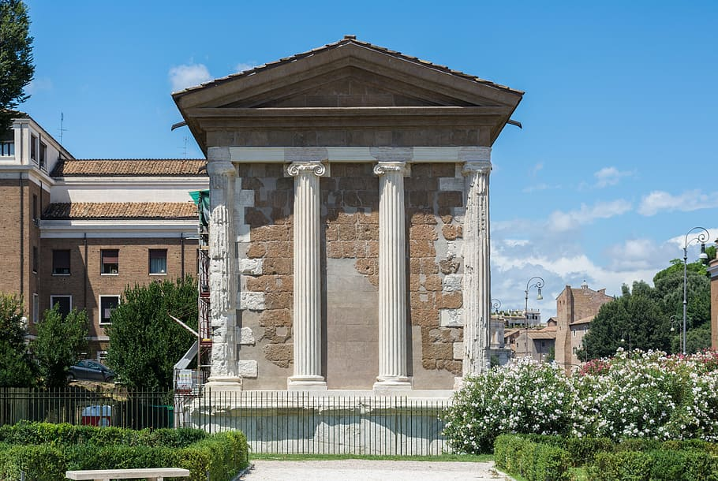
Who was the First Person to Build a Roman Temple?
Gaius Julius Lacer

Slide 7
Blooket Link Constructed By Milin and Loz

Slide 8
Work Cited
https://en.wikipedia.org/wiki/Roman_temple_of_Alc%C3%A1ntara#:~:text=The%20bridge%2C%20triumphal%20arch%20and,his%20work%20in%20103%20AD.
https://www.amusingplanet.com/2018/10/maison-carree-most-intact-roman-temple.html
https://www.ukessays.com/essays/architecture/how-were-roman-temples-designed-and-what-were-their-functions-3338.php#:~:text=Roman%20temples%20were%20the%20visual,of%20worship%20for%20that%20god.
https://study.com/academy/lesson/the-roman-temple-architecture-parts-facts.html#:~:text=The%20Roman%20temple%20was%20one,achievements%20of%20the%20ancient%20Romans.
Google Image Search

